Slide 1

All things Python @ Pivotal (Data Science)
https://xkcd.com/353/
Srivatsan Ramanujam
Principal Data Scientist
Pivotal Labs
@being_bayesian
Oct 15, 2015
POSH meetup
Joint work with Pivotal Data Science & MADlib team

Slide 2






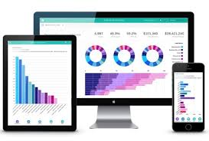
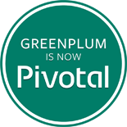




About Me
Research Intern
Software Engineer Analytics
Machine Learning Engineer (Drug Discovery)
Graduate School
Natural Language Scientist
Principal Data Scientist,
Data Science R&D Lead
https://www.linkedin.com/pub/srivatsan-ramanujam/7/91b/888

Slide 3
Agenda
Pivotal Data Science – Introduction
Technology Stack
Python on the client
Python on our Big Data Platform (BDS)
Data Parallelism
Model Parallelism
Python on our Cloud Platform (PCF)
Putting it all together – demo!

Slide 4
Pivotal Data Science – Introduction

Slide 5
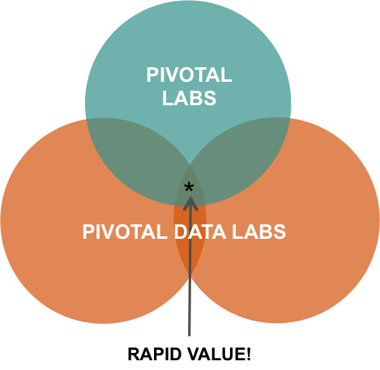
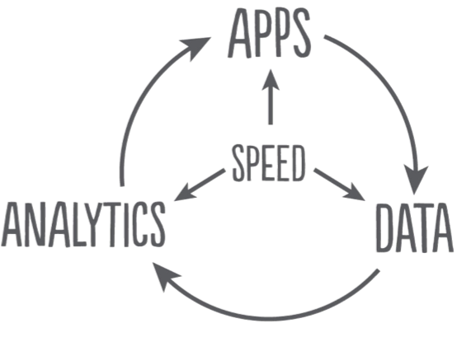

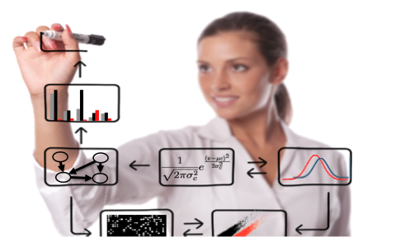

Pivotal Data Science
Our Charter:
Pivotal Data Science is Pivotal’s differentiated and highly opinionated data-centric service delivery organization (part of Pivotal Labs)
Our Goals:
Expedite customer time-to-value and ROI, by driving business-aligned innovation and solutions assurance within Pivotal’s Data Fabric technologies.
Drive customer adoption and autonomy across the full spectrum of Pivotal Data technologies through best-in-class data science and data engineering services, with a deep emphasis on knowledge transfer.
App Dev
Data Science
Data Engineering

Slide 6
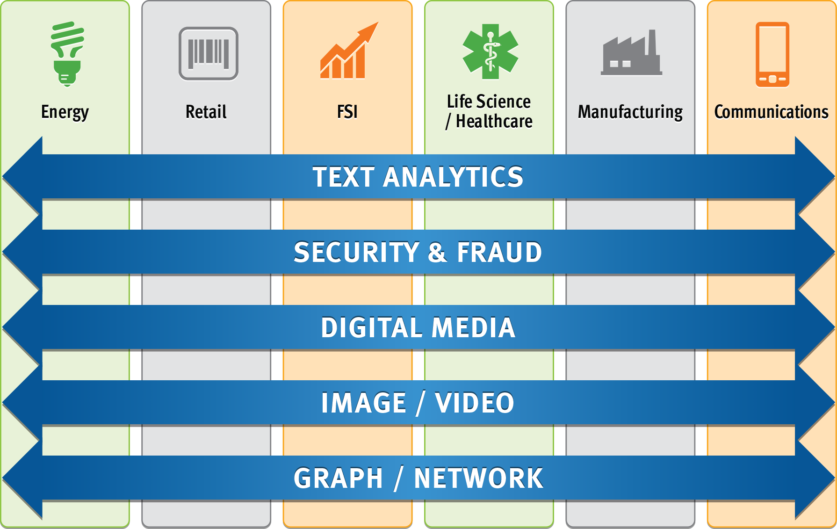
Pivotal Data Science Knowledge Development

Slide 7
PIVOTAL DATA SCIENCE TEAM
Annika Jimenez – Global head of Data Science Services (Sr. Director, Audience and Advertising Analytics at Yahoo!, M.I.A. in International Management, UCSD)
Kaushik Das – Mathematical Modeling in Energy, Retail and Telco(Director of Analytics at M-Factor, M.S. in Mineral Engineering, UC Berkeley)
Michael Brand –Text, Speech and Video Research for Retail, Finance and Gaming (Chief Scientist at Verint Systems, M.S. in Applied Mathematics, Weizmann Institute)
Woo Jung – Bayesian Inference and Demand Analysis (Sr. Statistician at M-Factor, M.S. in Statistics, Stanford)
Noelle Sio – Digital Media Analytics and Mathematical Modeling (Sr. Analyst at eHarmony, Fox Interactive Media (Myspace), M.S. in Applied Mathematics, Cal Poly Pomona)
Rashmi Raghu – Computational Methods and Analysis (Ph.D. in Mechanical Engineering, Stanford)
Jarrod Vawdrey – Marketing Analytics & SAS (Analytics Consultant at Aspen Marketing, B.S. in Mathematics, Kennesaw State University)
Sarah Aerni – Genomics and Machine Learning (Ph.D. in Biomedical Informatics, Stanford)
Srivatsan Ramanujam – NLP and Text Mining (Natural Language Scientist at Sony, Salesforce.com, M.S. in Computer Sciences, UT Austin)
Niels Kasch – Text Analytics and NLP (Ph.D. in Computer Science, UMBC)
Regunathan Radhakrishnan – Machine Learning, Signal Processing, Multimedia Content Analysis, Fingerprinting & Watermarking (Research Staff at Dolby Laboratories, MERL, Ph.D. in Electrical Engineering, NYU-Poly, Brooklyn)
Cao Yi – Optimization and Statistical Data Mining (Sr. Marketing Analyst at Energy Market Company Singapore, Ph.D. in Operations Research, National University of Singapore)
Ian Huston – Numerical Modeling, Simulation, and Analysis (Ph.D. in Theoretical Cosmology, Queen Mary, University of London)
Michael Natusch – Director EMEA Data Science (Chief Analyst at Cumulus Analytics, Ph.D. in Theoretical Condensed Matter Physics, University of Cambridge)
Greg Whalen – Director APJ Data Science (VP, Global Development Center at Experian, M.S. in Computer Science, Columbia University)
Hulya Farinas – Optimization, Resource Allocation in Healthcare (Modeler at M-Factor, IBM, Ph.D. in Operations Research, University of Florida)
Derek Lin – Network Security, Fraud Detection, Speech and Language Processing, (Principal Scientist at RSA, M.S. in Signal Processing, USC)
Kee Siong Ng – Statistical Modeling in Energy, Retail and Healthcare (Consulting Lead Data Scientist at Reliance, Ph.D. in Computer Science, Australian National University)
Jin Yu – Stochastic Optimization, Robust Statistics in Machine Learning, Computer Vision (Research Associate at U of Adelaide, Ph.D. in Machine Learning, Australian National University)
Gautam Muralidhar – PhD Biomed UT Austin, Image Processing, Signal Processing
Ailey Crow – PhD Bio-physics, UC Berkeley, Image Processing, Bio Med
Hong Ooi – Insurance and Finance Risk Modeling (Statistician at ANZ, Ph.D. in Statistics, Australian National University)
Mariann Micsinai – Next Generation Sequencing (Market Risk Management Associate at Lehman Brothers, Ph.D. in Computational Biology, NYU / Yale)
Victor Fang – Imaging and Graph Analytics, Machine Learning (Sr. Scientist at Riverain Medical, Ph.D. in Computer Sciences, University of Cincinnati)
Anirudh Kondaveeti – Trajectory Data Mining and Machine Learning (Ph.D. in Computing & Dec. Systems Eng, Arizona State University)
Alexander Kagoshima – Time Series, Statistics and Machine Learning (M.S. in Economics/Computer Science, TU Berlin)
Ronert Obst – Machine Learning, Bayesian Inference, Time Series (M.S. in Statistics, LMU Munich)

Slide 8
Technology and Tools

Slide 9















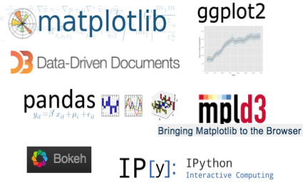

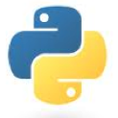
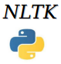


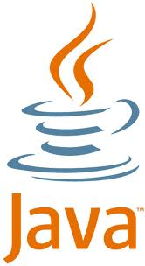


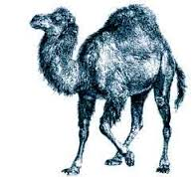






Data Science Toolkit
Platform
P L A T F O R M
KEY TOOLS
KEY LANGUAGES
PL/X
Modeling Tools
Visualization Tools
MLlib

Slide 10









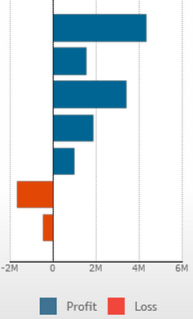
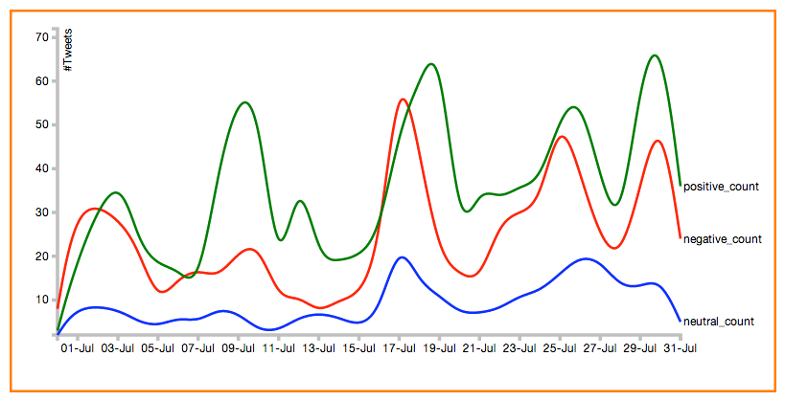
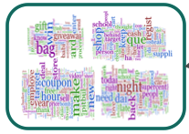
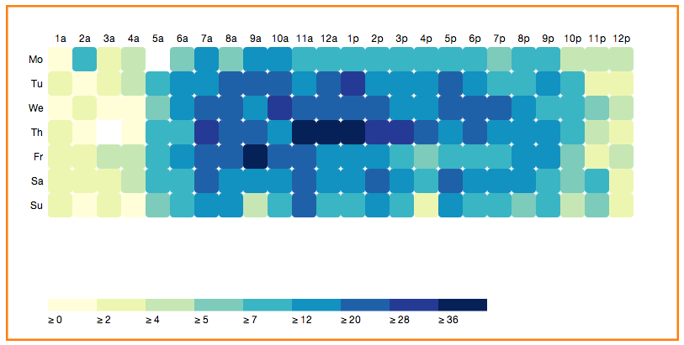


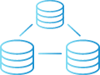

Pipeline of a Data Science Driven App
Data Feeds
Apps
Continuous Model Improvement
Ingest
Filter
Enrich
Sink
SpringXD
Model Building
Model Tuning
PL/X
Data Lake
Business Levers
Greenplum
MLlib

Slide 11
Python on the client

Slide 12
Data Science Lab – Sample Timeline
Week
2 | 4 | 6 | 8 | 10 | 12
Data Review
Data Review
Feature Creation
Feature Review
Model Development
Optimization & Validation
Model Review
Code QA & Scoring
Knowledge Transfer
Insights Presentation
Model and Code Handoff
Phase 2
Phase 3
Phase 4 Model Building
Phase 5 Model Enablement

Slide 13
Data Science Storytelling
We primarily use Python on the client (laptop) for data exploration, visualization and data science story-telling.
Complex statistical models and data wrangling are run in the backend on our Big Data Suite (MPP databases like Greenplum and HAWQ).
We typically use a connector like psycopg2 to talk to the backend database and use a Jupyter notebook to document our analysis on a laptop.

Slide 14
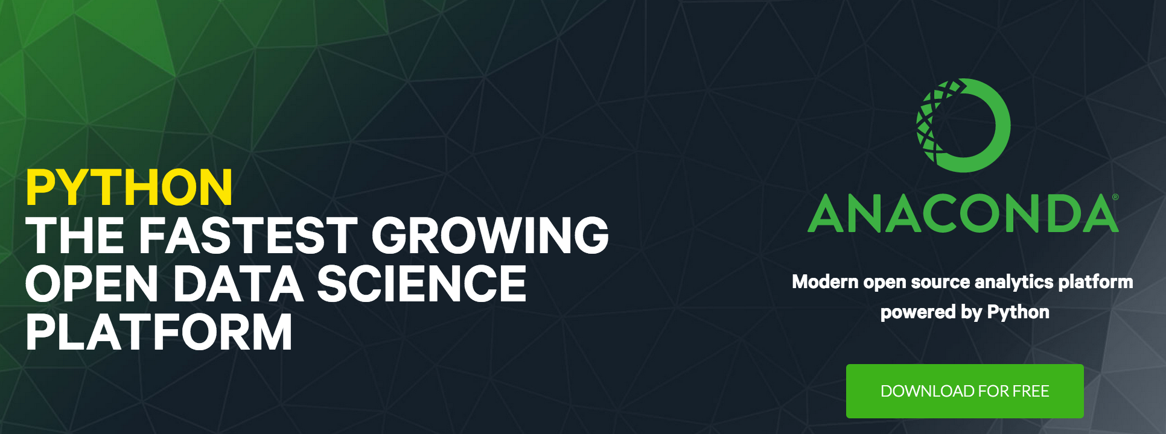
Python Distribution
We love Anaconda - Python with “batteries included”
Contains all the great libraries in the PyData stack that we often use for data science (numpy, scipy, sklearn, statsmodels, searborn, matplotlib, nltk etc.)
Conda package manager takes the pain out of Python package management (remember the dreaded “pip install numpy scipy matplotlib” ?)

Slide 15

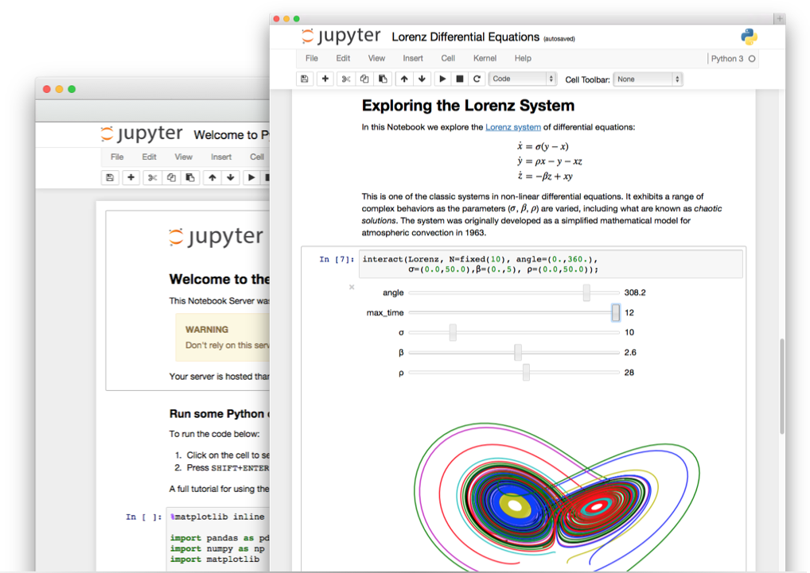
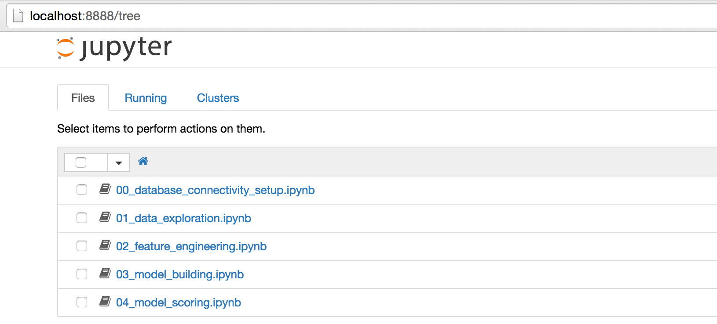
Notebooks
Open source, interactive data science and scientific computing across over 40 programming languages.
Great for data science story-telling
Living document, models and insights “don’t die in Powerpoint slides”.
Data science lab templates
https://jupyter.org/

Slide 16
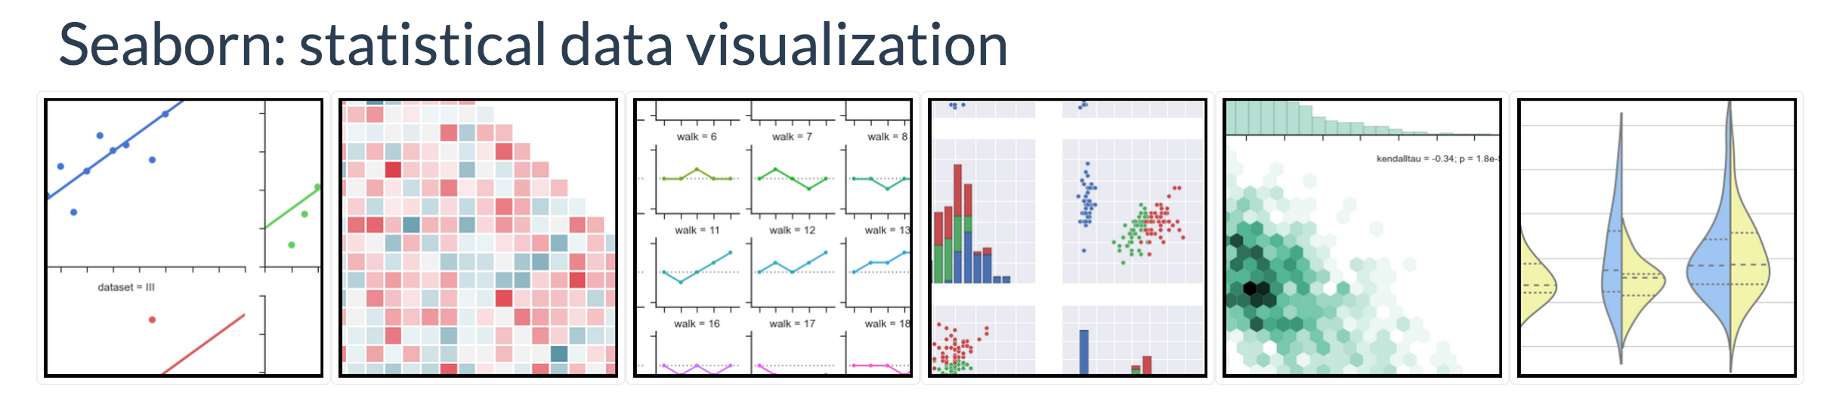
Seaborn
Based on Matplotlib with the aesthetics of ggplot2 (thank you Michael Waskom!)
Intuitive interface, tightly integrated with PyData stack including support for numpy and pandas data structures and statistical routines from scipy and statsmodels.
http://stanford.edu/~mwaskom/software/seaborn/index.html

Slide 17
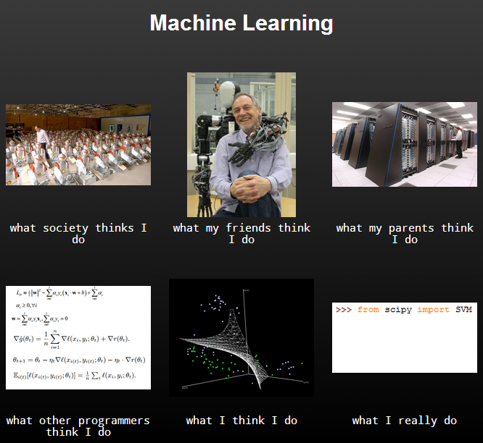
What about machine learning?
Source: the interwebs

Slide 18
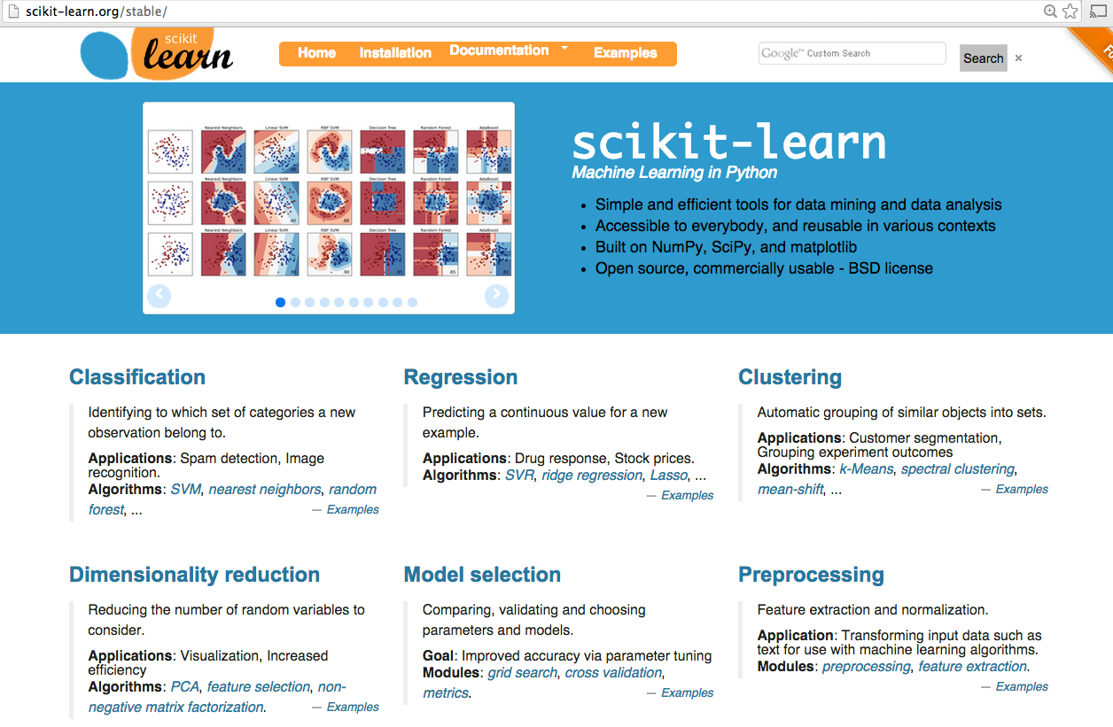
Machine Learning in Python : Scikit Learn
http://scikit-learn.org/stable/

Slide 19
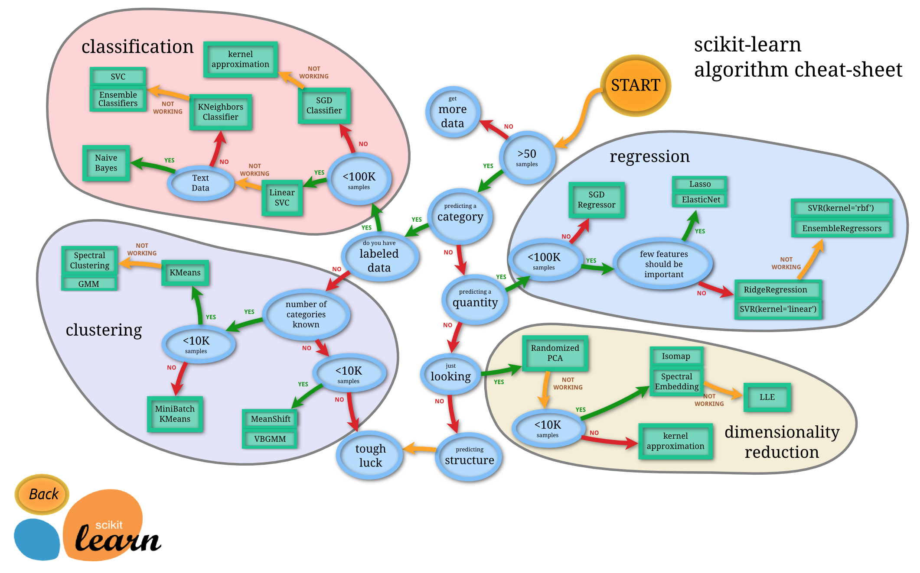
Scikit Learn Cheat Sheet
‘Cheat’ with care ☺
http://scikit-learn.org/stable/tutorial/machine_learning_map/

Slide 20
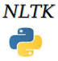
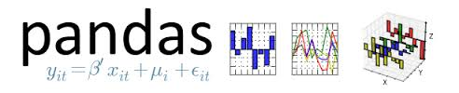





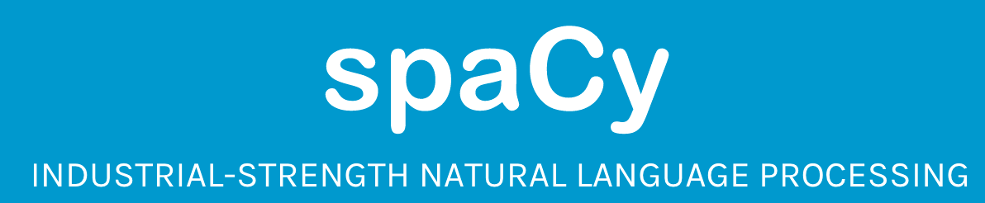
Numerous other libraries
topic modeling for humans
PyMC

Slide 21
Python in-database

Slide 22


Data Parallelism through PL/X : X in Python, R, Java, C/C++ and pgSQL
For embarrassingly parallel tasks, we can use procedural languages to easily parallelize any stand-alone library in Java, Python, R, pgSQL or C/C++
The interpreter/VM of the language ‘X’ is installed on each node of the MPP environment
SQL
Master
Host
Standby
Master
Interconnect
Segment Host
Segment
Segment
Segment Host
Segment
Segment
Segment Host
Segment
Segment
Segment Host
Segment
Segment
…
plpython and python are loaded as dynamic libraries on the master and segment nodes (libpython.so and plpython.so are under $GPHOME/ext/python)

Slide 23
What exactly does PL/Python do?
Input Conversion
Output Conversion
PostgreSQL type | Python type
boolean | bool
smallint, Int | int
bigint | Long (py2.x), int (py 3.x)
real, double | float
numeric | decimal
bytea | str in (py2.x), bytes (py3.x)
array | list
record | Python mapping (dict)
NULL | None
PostgreSQL type | Python type
boolean | 0, ‘’ is false
bytea | retval -> str -> bytea
record | retval can be list, tuple or dict, but not set
Everything else | retval is converted to python str and constructor for corresponding postgres datatype is invoked

Slide 24
User Defined Functions (UDFs) in PL/Python
Procedural languages need to be installed on each database used.
Syntax is like normal Python function with function definition line replaced by SQL wrapper. Alternatively like a SQL User Defined Function with Python inside.
CREATE FUNCTION pymax (a integer, b integer)
RETURNS integer
AS $$
if a > b:
return a
return b
$$ LANGUAGE plpythonu;
SQL wrapper
Normal Python
SQL wrapper

Slide 25
Returning Results
Postgres primitive types (int, bigint, text, float8, double precision, date, NULL etc.)
Composite types can be returned by creating a composite type in the database:
CREATE TYPE named_value AS (
name text,
value integer
);
Then you can return a list, tuple or dict (not sets) which reference the same structure as the table:
CREATE FUNCTION make_pair (name text, value integer)
RETURNS named_value
AS $$
return [ name, value ]
# or alternatively, as tuple: return ( name, value )
# or as dict: return { "name": name, "value": value }
# or as an object with attributes .name and .value
$$ LANGUAGE plpythonu;
For functions which return multiple rows, prefix “setof” before the return type
http://www.slideshare.net/PyData/massively-parallel-process-with-prodedural-python-ian-huston

Slide 26
Returning more results
You can return multiple results by wrapping them in a sequence (tuple, list or set), an iterator or a generator:
CREATE FUNCTION make_pair (name text)
RETURNS SETOF named_value
AS $$
return ([ name, 1 ], [ name, 2 ], [ name, 3])
$$ LANGUAGE plpythonu;
Sequence
CREATE FUNCTION make_pair (name text)
RETURNS SETOF named_value AS $$
for i in range(3):
yield (name, i)
$$ LANGUAGE plpythonu;
Generator

Slide 27
Accessing Packages
On Greenplum DB: packages must be installed on the individual segment nodes.
Can use “parallel ssh” tool gpssh to install
Currently Greenplum DB ships with Python 2.6 (!)
Then just import as usual inside the UDF:
Anaconda PL/Python coming in GPDB 5.0
CREATE FUNCTION make_pair (name text)
RETURNS named_value
AS $$
import numpy as np
return ((name,i) for i in np.arange(3))
$$ LANGUAGE plpythonu;

Slide 28
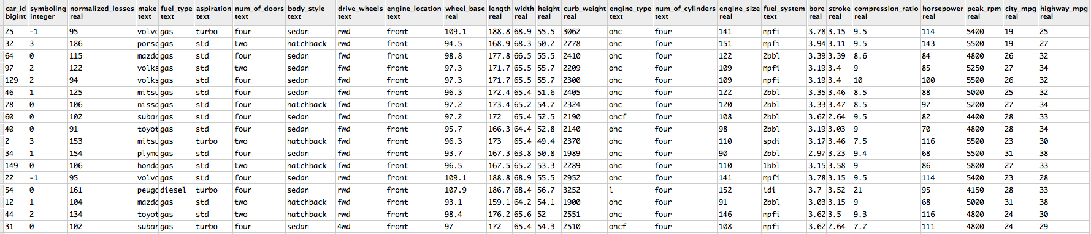
UCI Auto MPG Dataset – A toy problem
Sample Data
Sample Task: Aero-dynamics aside (attributable to body style), what is the effect of engine parameters (bore, stroke, compression_ratio, horsepower, peak_rpm) on the highway mpg of cars?
Solution: Build a Linear Regression model for each body style (hatchback, sedan) using the features bore, stroke, compression ration, horsepower and peak_rpm with highway_mpg as the target label.
This is a data parallel task which can be executed in parallel by simply piggybacking on the MPP architecture. One segment can build a model for Hatchbacks another for Sedan
http://archive.ics.uci.edu/ml/datasets/Auto+MPG

Slide 29
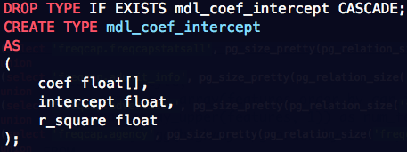
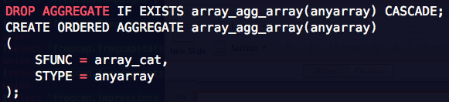
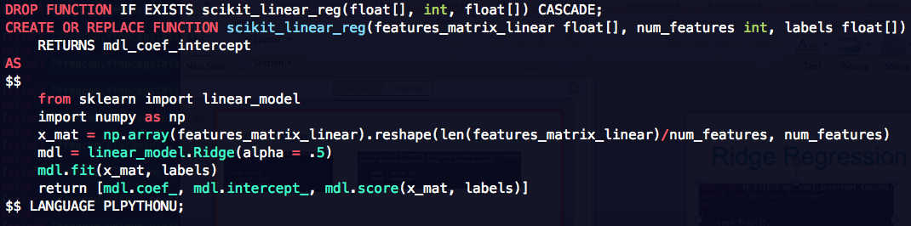
Ridge Regression with scikit-learn on PL/Python
User Defined Type
User Defined Aggregate
User Defined Function
SQL
wrapper
Python
SQL
wrapper

Slide 30
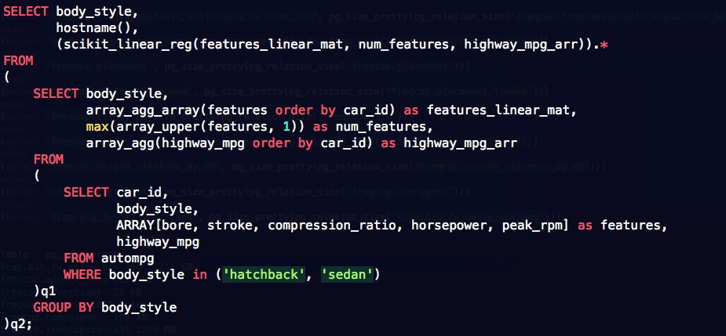
PL/Python + scikit-learn : Model Coefficients
Invoke UDF
Build Feature Vector
Choose Features
One model
per body style
Physical machine on the cluster in which the regression model was built

Slide 31
Model Parallelism
Data Parallel computation via PL/Python libraries only allow us to run ‘n’ models in parallel.
This works great when we are building one model for each value of the group by column, but we need parallelized algorithms to be able to build a single model on all the available data
For this, we use MADlib – an open source library of parallel in-database machine learning algorithms.

Slide 32
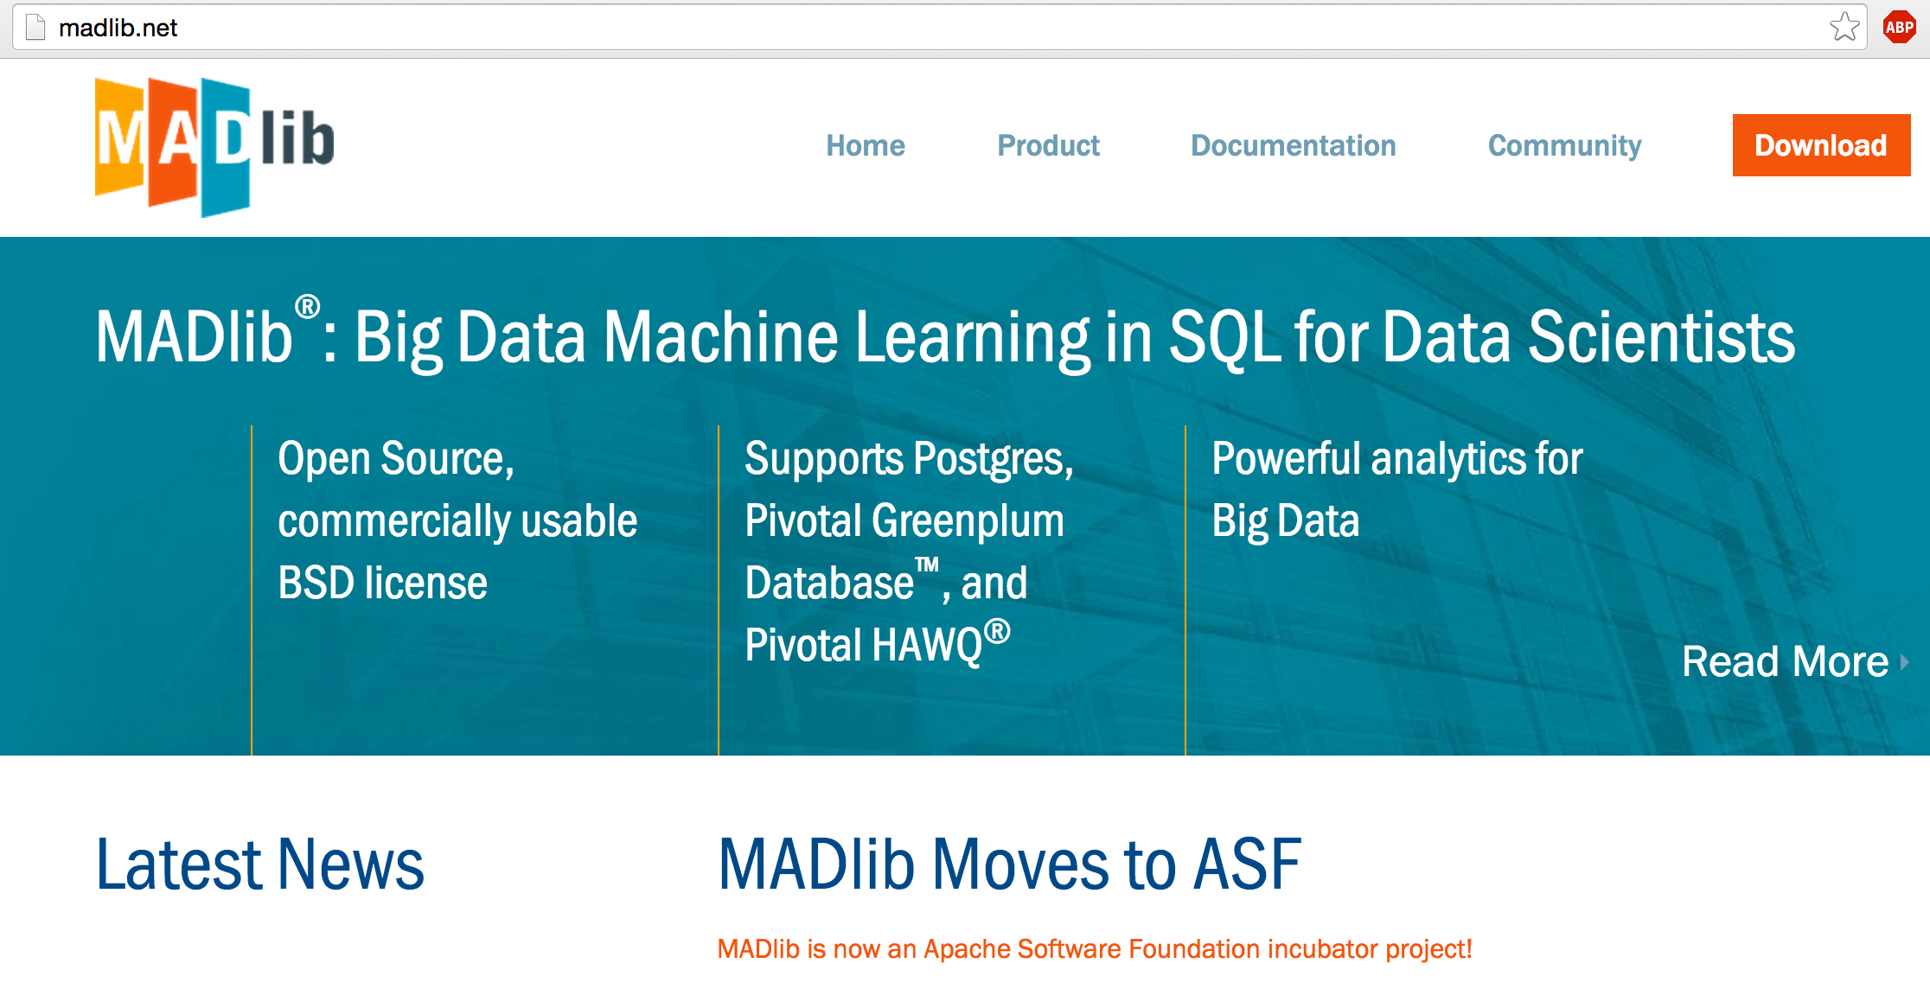
MADlib : Scalable, in-database Machine Learning
http://vldb.org/pvldb/vol5/p1700_joehellerstein_vldb2012.pdf

Slide 33


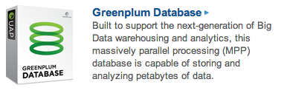

Supported Platforms
PHD
HDP
Other ODPi distros
GPDB
PostgreSQL
@MADlib_analytic
Notes:
Potential for much broader user base of MADlib given that it now supports HDP and other distros derived from Open Data Platform (ODPi)

Slide 34
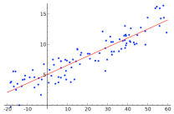
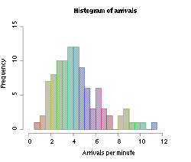
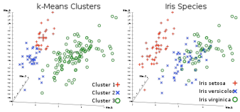
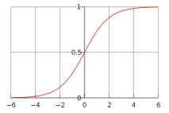
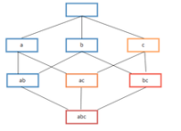
Functions
Predictive Analytics Library
Supervised Learning
Regression Models
Cox Proportional Hazards Regression
Elastic Net Regularization
Generalized Linear Models
Linear Regression
Logistic Regression
Marginal Effects
Multinomial Regression
Ordinal Regression
Robust Variance, Clustered Variance
Support Vector Machines
Tree Methods
Decision Tree
Random Forest
Other Methods
Conditional Random Field
Naïve Bayes
Unsupervised Learning
Association Rules (Apriori)
Clustering (K-means)
Topic Modeling (LDA)
Data Types and Transformations
Array Operations
Dimensionality Reduction (PCA)
Encoding Categorical Variables
Matrix Operations
Matrix Factorization (SVD, Low Rank)
Norms and Distance Functions
Sparse Vectors
Time Series
ARIMA
Model Evaluation
Cross Validation
Statistics
Descriptive
Cardinality Estimators
Correlation
Summary
Inferential
Hypothesis Tests
Other Statistics
Probability Functions
Other Modules
Conjugate Gradient
Linear Solvers
PMML Export
Random Sampling
Term Frequency for Text
Aug 2015
@MADlib_analytic
Notes:
MADlib currently has more than 30 principle algorithms
In addition to predictive analytics, recently doing more in the area of utilities like matrix operations, pathing, pivoting, etc.

Slide 35


Architecture
User Interface
SQL
RDBMS
Built-in Functions
High-level Iteration Layer
(iteration controller, …)
Python
Functions for Inner Loops
(implements ML logic)
C++
Low-level Abstraction Layer
(array operations,
C++ to DB type-bridge, …)
Eigen
C API
(Greenplum, PostgreSQL, HAWQ)
@MADlib_analytic

Slide 36
Convex optimization framework
Each step has an analytical formulation that can be performed in parallel
@MADlib_analytic

Slide 37
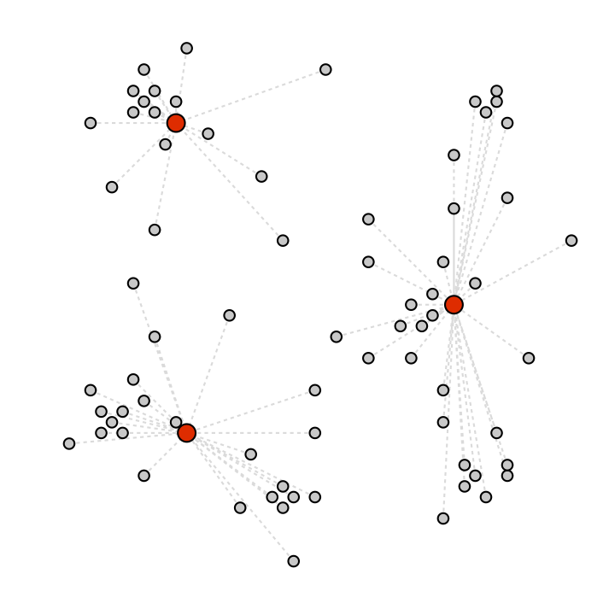
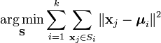
What are our customers saying about us?
k-means clustering:
finding items that are similar within an n-dimensional space
Lloyd’s local-search heuristic works well in practice
Two fundamental steps:
Assign each point to its closest centroid
Move each centroid to the barycenter/mean of all points currently assigned to it
@MADlib_analytic

Slide 38
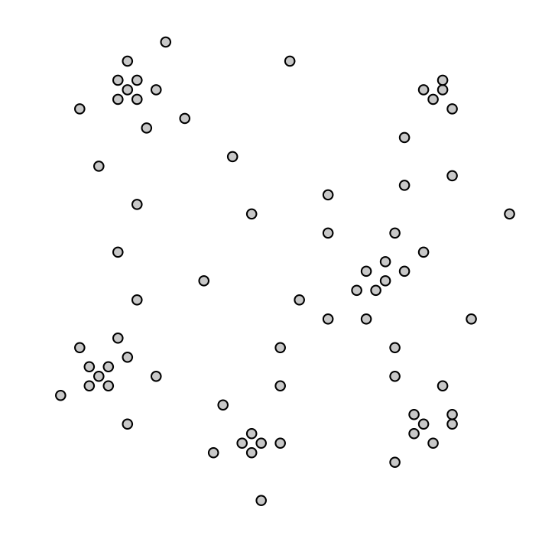
What are our customers saying about us?
@MADlib_analytic

Slide 39
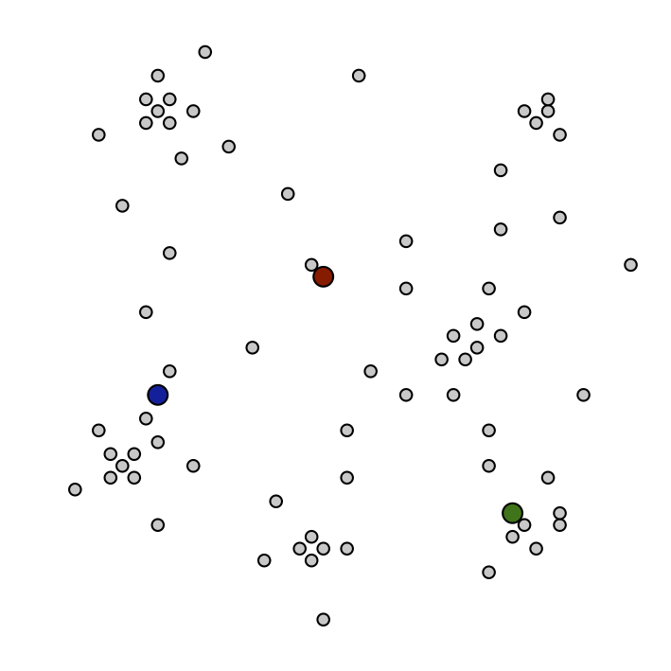
What are our customers saying about us?
@MADlib_analytic

Slide 40
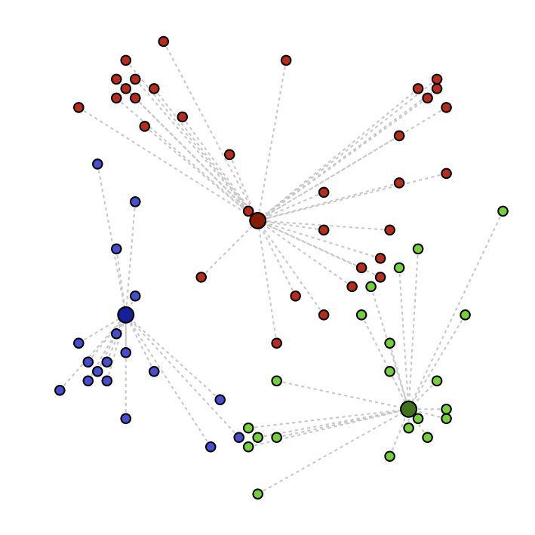
What are our customers saying about us?
@MADlib_analytic

Slide 41
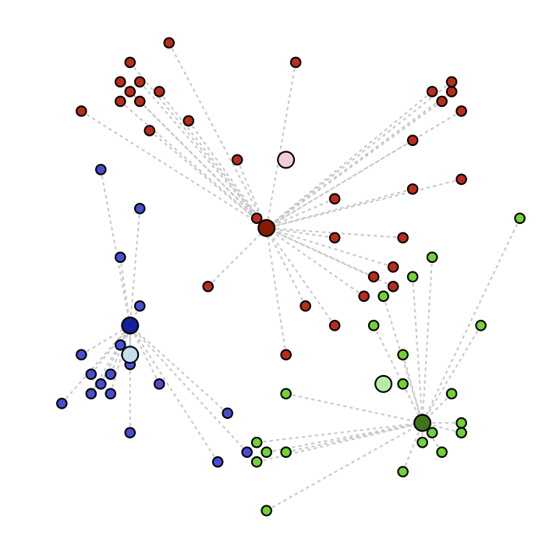
What are our customers saying about us?
@MADlib_analytic

Slide 42
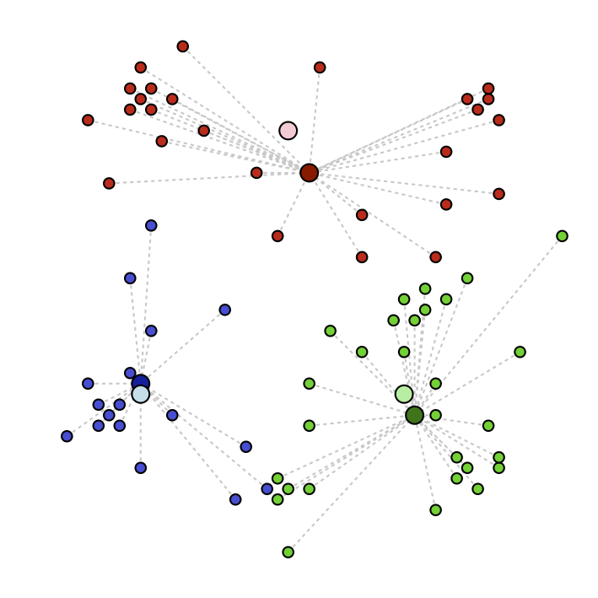
What are our customers saying about us?
@MADlib_analytic

Slide 43
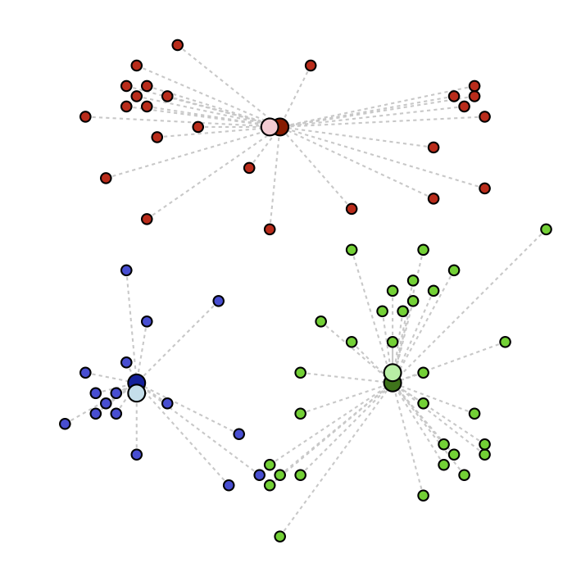
What are our customers saying about us?
@MADlib_analytic

Slide 44
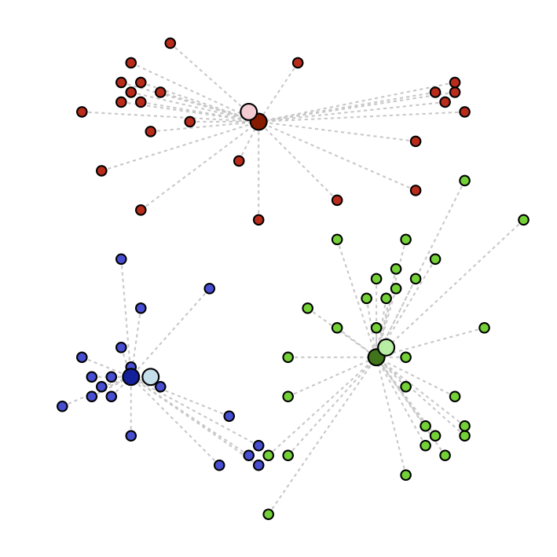
What are our customers saying about us?
@MADlib_analytic

Slide 45
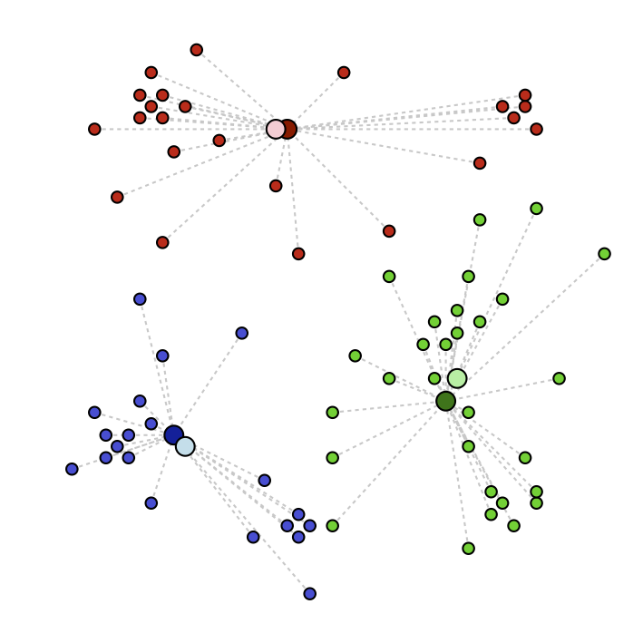
What are our customers saying about us?
@MADlib_analytic

Slide 46
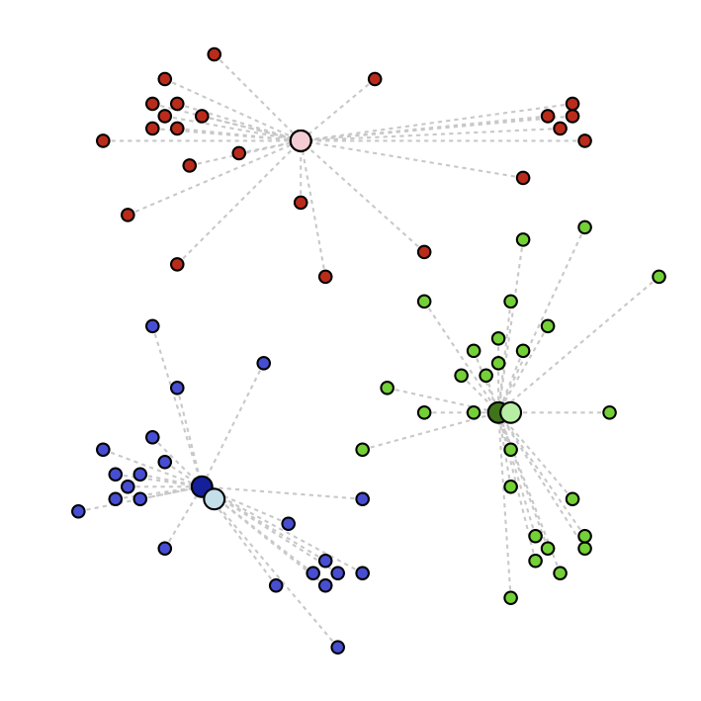
What are our customers saying about us?
@MADlib_analytic

Slide 47
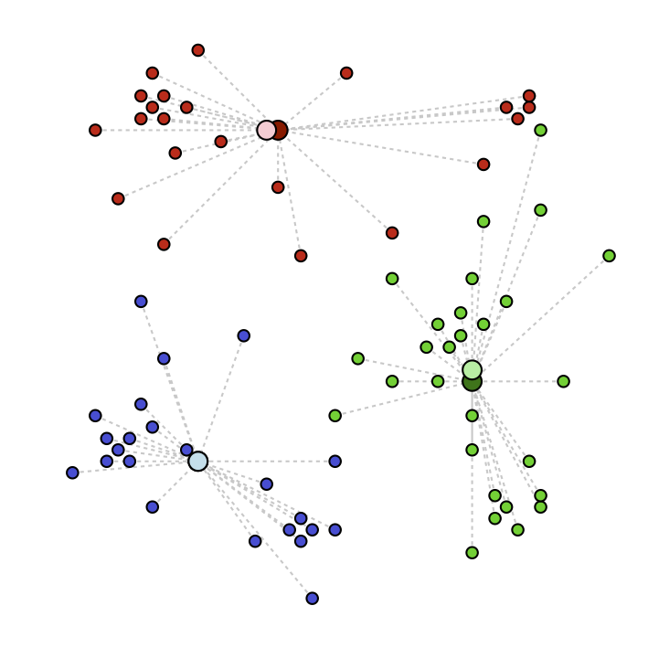
What are our customers saying about us?
@MADlib_analytic

Slide 48

What are our customers saying about us?
@MADlib_analytic

Slide 49

What are our customers saying about us?
@MADlib_analytic

Slide 50

What are our customers saying about us?
@MADlib_analytic

Slide 51
What are our customers saying about us?
innova
leader
design
bug
installation
download
speed
graphics
improvement
@MADlib_analytic

Slide 52
K-means: Parallel Computation
Segment 1
Segment 2
Master
Iteration end
@MADlib_analytic

Slide 53

Driver Functions in PL/Python
Every PL/Python UDF has access to a module called plpy, which allows you to execute SQL queries from within the PL/Python UDF
Gives the ability to “drive” distributed computation
Runs on the master only
Will run and fetch data from segment nodes
Runs on the master only
plpy.debug(msg), plpy.log(msg), plpy.info(msg), plpy.notice(msg), plpy.warning(msg), plpy.error(msg) are useful utility functions for logging

Slide 54


In-database parallel grid search using
XGBoost (eXtreme Gradient Boosting) is a popular library used in many prize winning Kaggle contests.
Implemented in C++ with Python and R bindings
Supports multi-core
Implemented in-database parallel grid-search for XGBoost using PL/Python
https://github.com/vatsan/gp_xgboost_gridsearch

Slide 55


In-database grid search - Approach
structured, unstructured
data sources
grid search
params dict
pickle and distribute
master
Grid params table (expanded)
segments
Driver function (PL/Python)
param-list-1
. . .
param-list-n
feature gen.
pipeline
training set(serialized)
training set(serialized)
training dataset (distributed table)
mdl-1
. . .
mdl-n
Refreshed data (incoming daily/weekly/monthly updates)
scored results
Model selection
https://github.com/vatsan/gp_xgboost_gridsearch

Slide 56


Model Training and Scoring : XGBoost
Training
Scoring
https://github.com/vatsan/gp_xgboost_gridsearch

Slide 57
Python on Cloud Foundry
Ian Huston, Ronert Obst, Alex Kagoshima

Slide 58

What is Cloud Foundry?
http://cloudfoundry.org
Open Source Cloud Platform
Simple App Deployment, Scaling & Availability
No Cloud Provider Lock In
@ianhuston

Slide 59
How can CF help data scientists?
Jamie is a data scientist who has just finished some analysis. They want to put up a simple internal web app with Javascript visualisations connected to internal data stores.
Sam is a data engineer who wants to set up a REST API to expose a production machine learning model as a service.
Alex is a data scientist who has an existing RShiny or Python app that they want to make available with multiple instances.
@ianhuston

Slide 60

Cloud Foundry is a Platform
You bring the apps, the rest is taken care of!
Source: Albert Barron (IBM),
https://www.linkedin.com/pulse/20140730172610-9679881-pizza-as-a-service
@ianhuston

Slide 61



































Cloud Foundry Foundation: Industry Standard
Gold
Silver
@ianhuston
Notes:
Cloud Foundry Foundation: Huge cross-section of the most important vendors committed millions to the technology
Cloud Foundry now ships with Ubuntu

Slide 62
CF for data scientists & developers
Easily deploy your web app
cf push myapp
Scale up and out quickly
cf scale myapp –i 5 –m 1G
Create and bind services
cf bind-service myapp redis
@ianhuston

Slide 63
Python on Cloud Foundry
First class language (with Go, Java, Ruby, Node.js, PHP)
Automatic app type detection
Looks for requirements.txt or setup.py
Buildpack takes care of
Detecting that a Python app is being pushed
Installing Python interpreter
Installing packages in requirements.txt using pip
Starting web app as requested (e.g. python myapp.py)
@ianhuston
Notes:
Python is a first class citizen
Automatic detection by buildpack (looks for requirements.txt or setup.py in root)
Uses Pip to get requirements and dependencies

Slide 64
Official Python Buildpack
Great for simple pip based requirements
Well tested and officially maintained
Covers both Python 2 and 3
Suffers from the Python Packaging Problem:
Hard to build packages with C, C++ or Fortran extensions
Complicated local configuration of libraries and paths needed
Takes a long time to build main PyData packages from source
@ianhuston

Slide 65

Using conda for package management
http://conda.pydata.org
Benefits:
Uses precompiled binary packages
No fiddling with Fortran or C compilers and library paths
Known good combinations of main package versions
Really simple environment management (better than virtualenv)
Easy to run Python 2 and 3 side-by-side
Go try it out if you haven’t already!
@ianhuston
Notes:
By Continuum Analytics

Slide 66
How to use the conda buildpack
https://github.com/ihuston/python-conda-buildpack
Specify as a custom buildpack when pushing app with manifest or -b command line option.
Export your current environment to a environment.yml file
Or write requirements.txt (pip) and conda_requirements.txt
Send me feedback & pull requests!

Slide 67
Putting it all together : Topic and Sentiment Analysis Demo
Srivatsan Ramanujam, Greg Cobb, Vinson Chuong, Ofri Afek, Jarrod Vawdrey, Joelle Gernez

Slide 68
Data Science + Agile = Quick Wins
The Team
1 Data Scientist
2 Agile Developers
1 Designer (part-time)
1 Project Manager (part-time)
Duration
3 weeks!

Slide 69


Text Analytics Pipeline
55 million tweets/day
Tweet Stream
Pivotal
Cloud Foundry
Stored on Data Lake
Topic Analysis through MADlib pLDA
(PXF/gpfdist)
Loaded as external tables
Parallel Parsing of JSON and extraction of fields using PL/Python
Sentiment Analysis through custom
PL/Python functions

Slide 70





Topic and Sentiment Analysis Engine (Demo)
http://www.slideshare.net/SrivatsanRamanujam/python-powered-data-science-at-pivotal-pydata-2013

Slide 71
Appendix

Slide 72
Pivotal Data Science Blogs
Scaling native (C++) apps on Pivotal MPP
Predicting commodity futures through Tweets
A pipeline for distributed topic & sentiment analysis of tweets on Greenplum
Using data science to predict TV viewer behavior
Twitter NLP: Scaling part-of-speech tagging
Distributed deep learning on MPP and Hadoop
Multi-variate time series forecasting
Pivotal for good – Crisis Textline
http://blog.pivotal.io/data-science-pivotal

